Slide 1
Fixed Inter-Individual Variability (n = 20)
var_intra | inflection_point
0.25 | 134.75
0.5 | 91.95
0.71 | 95.35
1 | 114.15

Slide 2
Fixed Inter-Individual Variability (n = 20)
Intra-individual variability = 0.25, inter-individual variability = 1

Slide 3
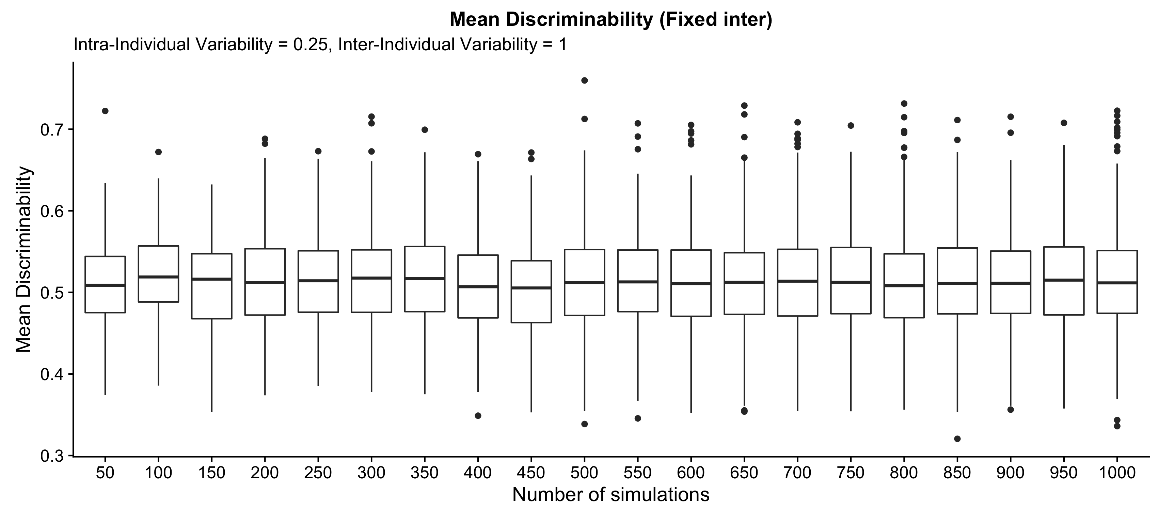

Slide 4
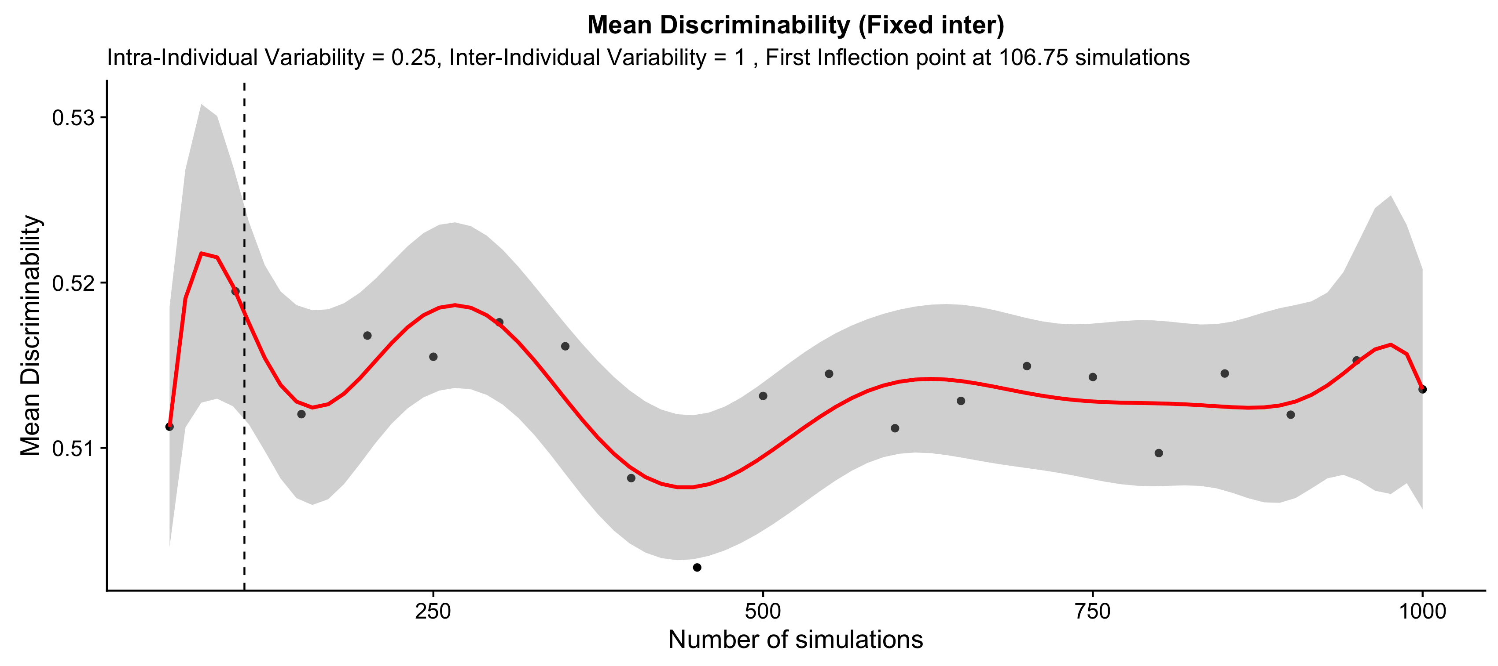

Slide 5
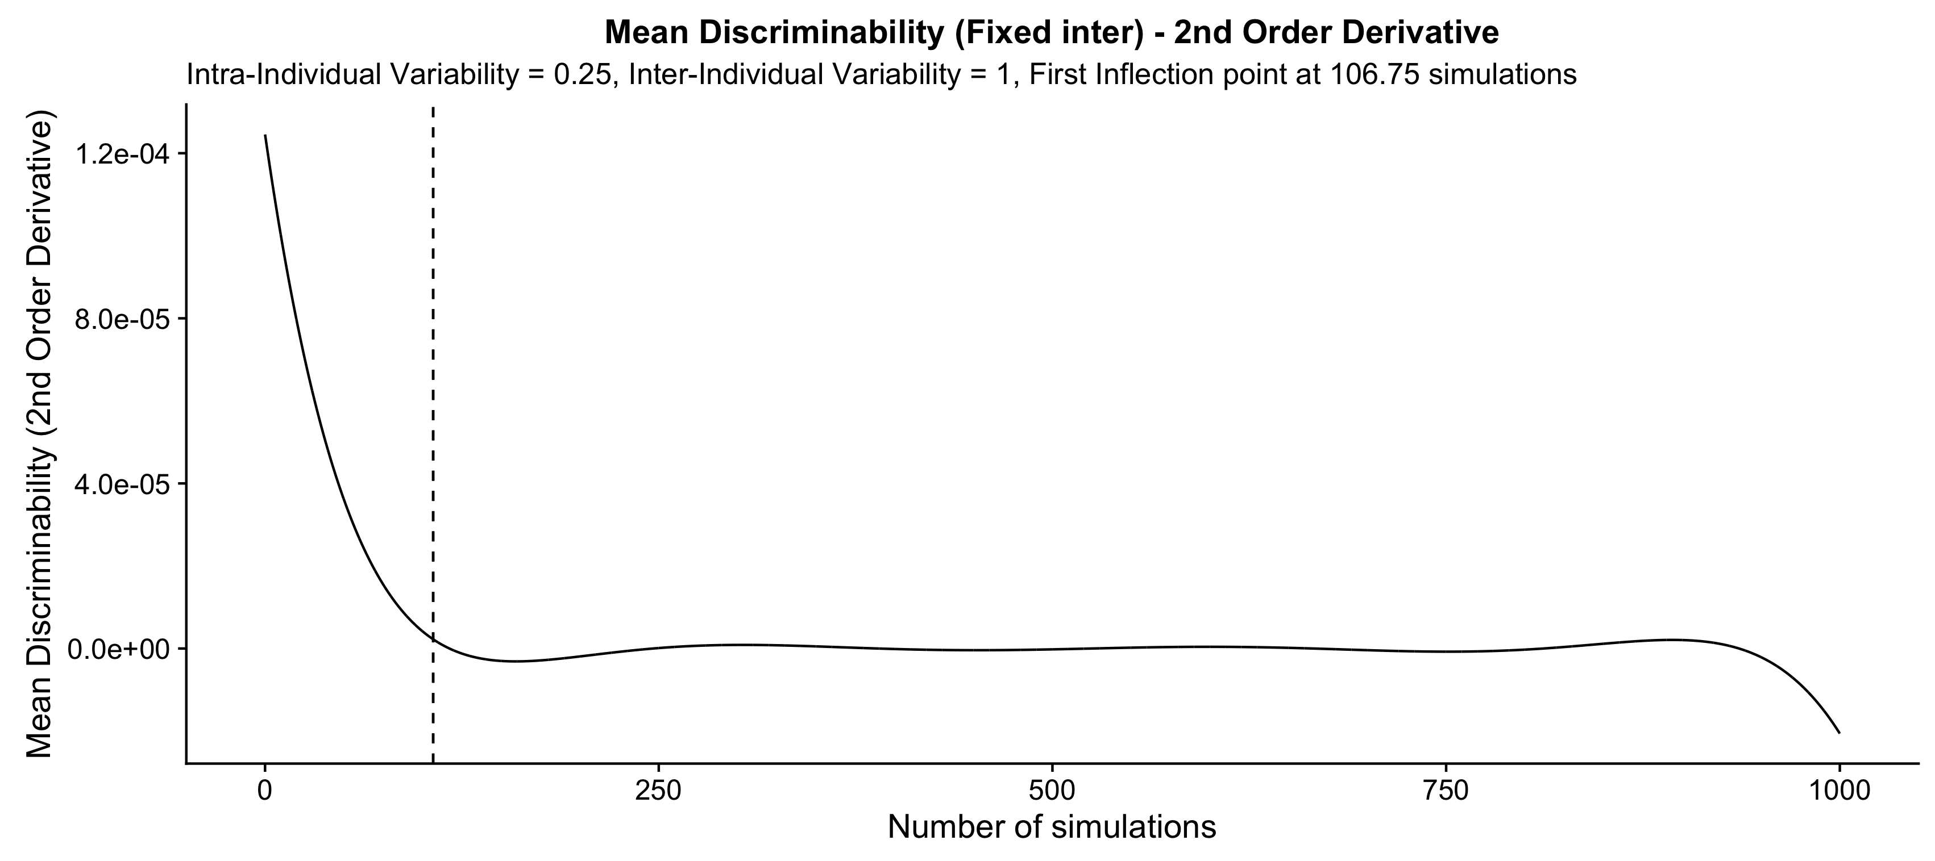

Slide 6
Fixed Inter-Individual Variability (n = 20)
Intra-individual variability = 0.50, inter-individual variability = 1

Slide 7
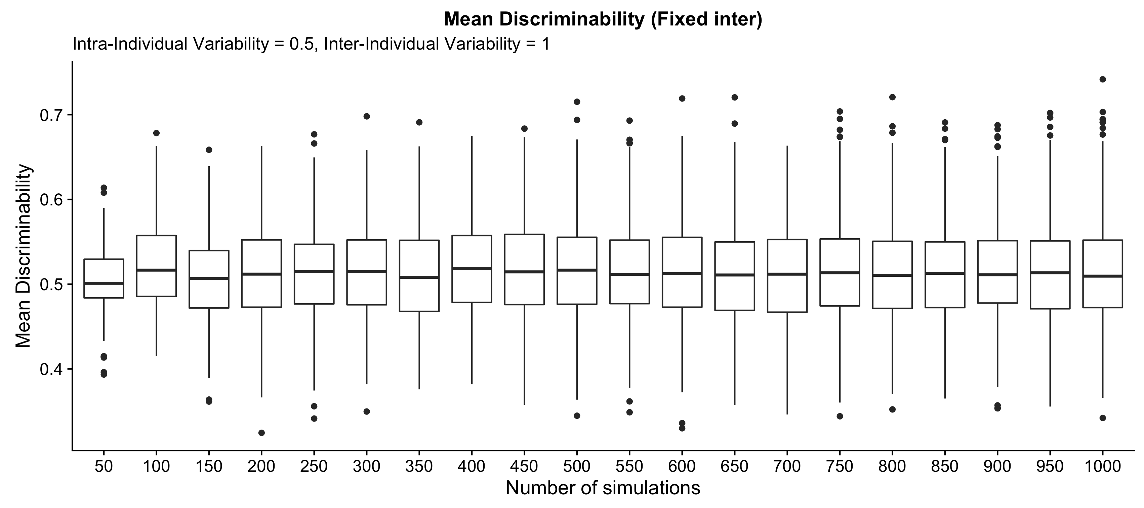

Slide 8
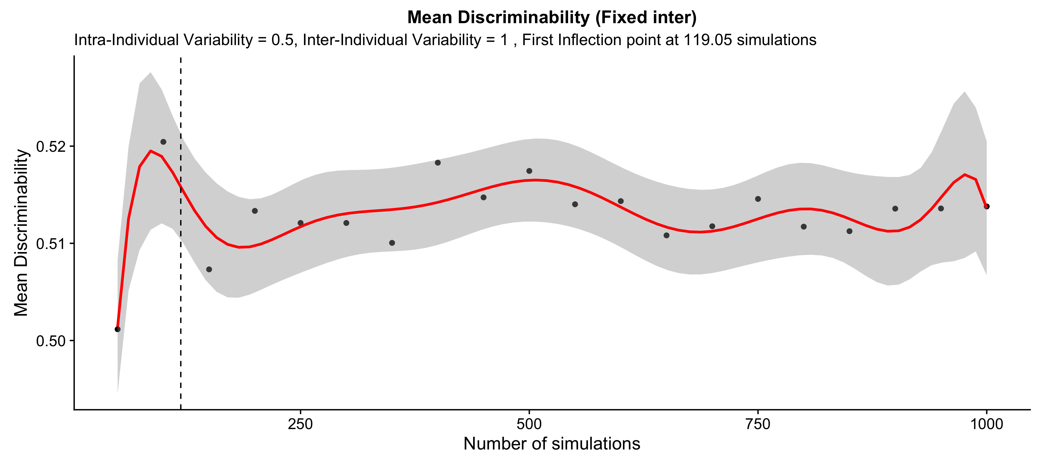

Slide 9


Slide 10
Fixed Inter-Individual Variability (n = 20)
Intra-individual variability = 0.71, inter-individual variability = 1

Slide 11
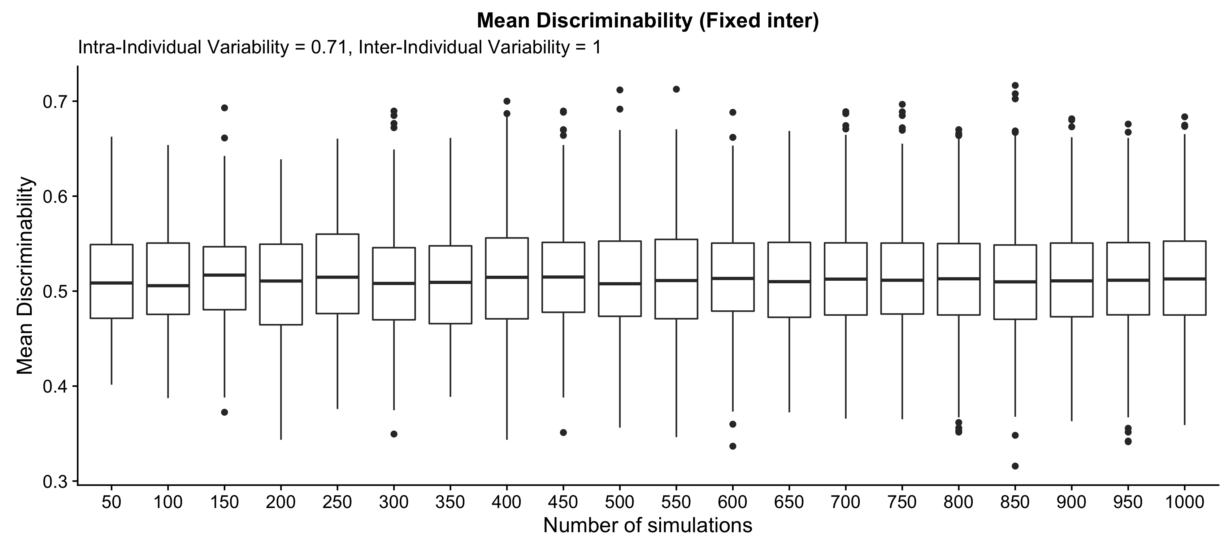

Slide 12
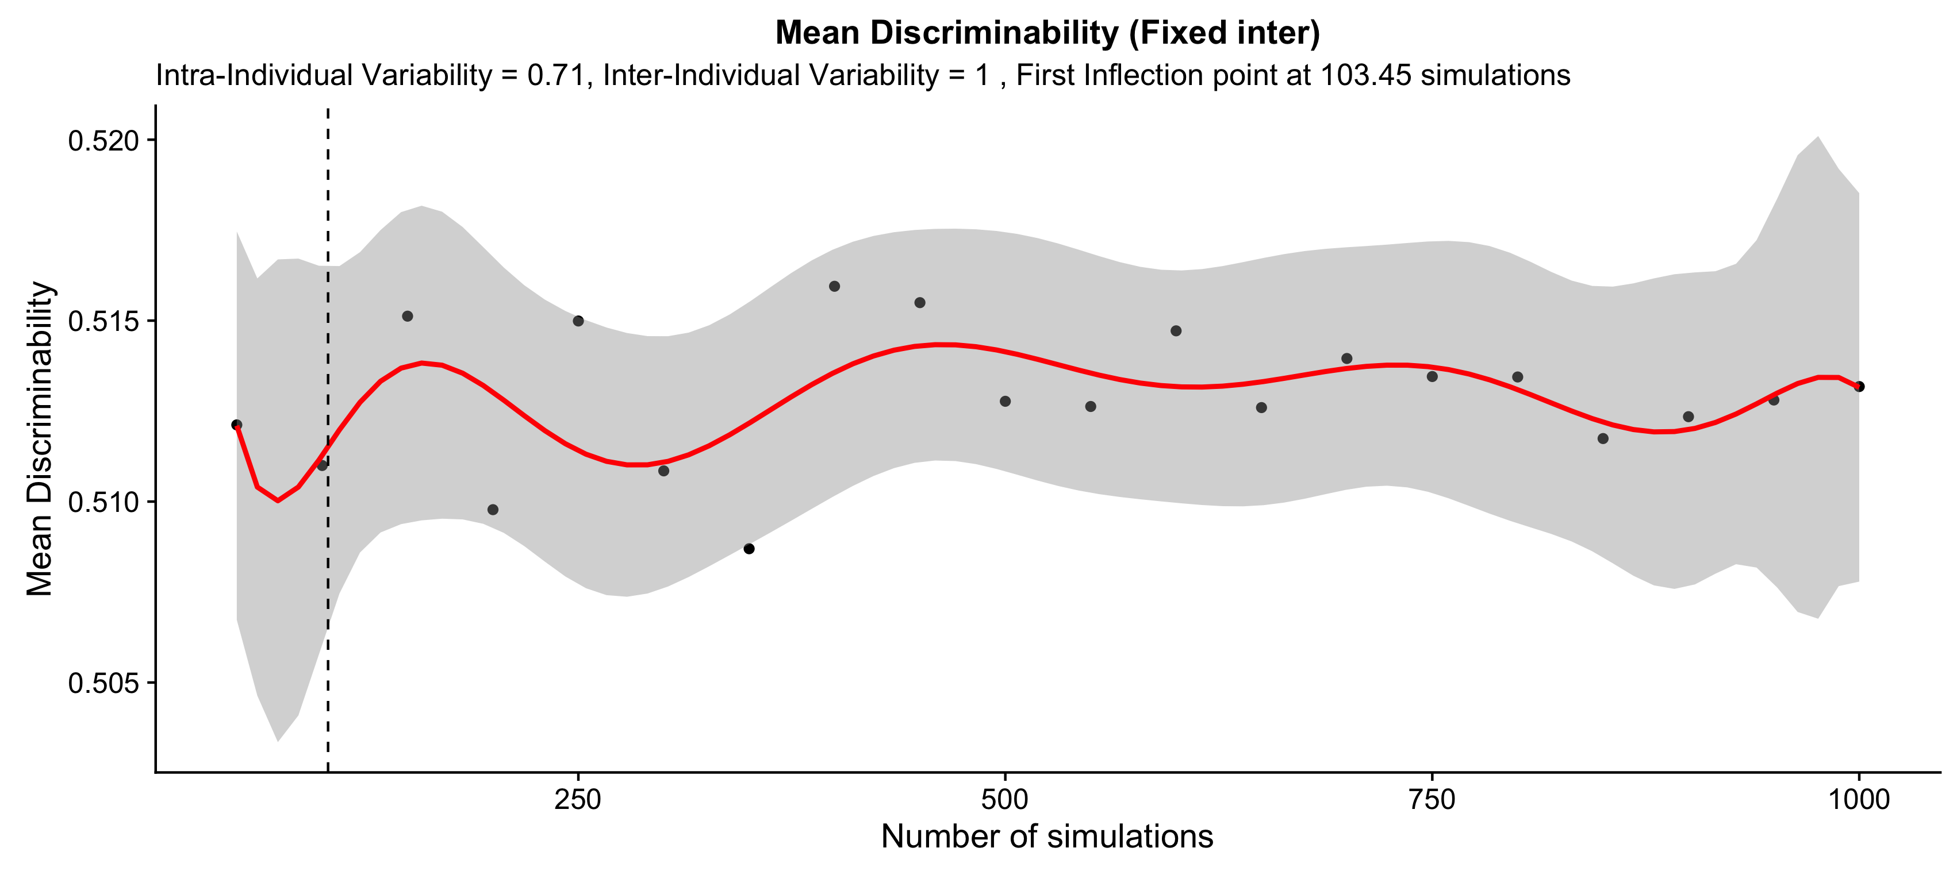

Slide 13


Slide 14
Fixed Inter-Individual Variability (n = 20)
Intra-individual variability = 1, inter-individual variability = 1

Slide 15
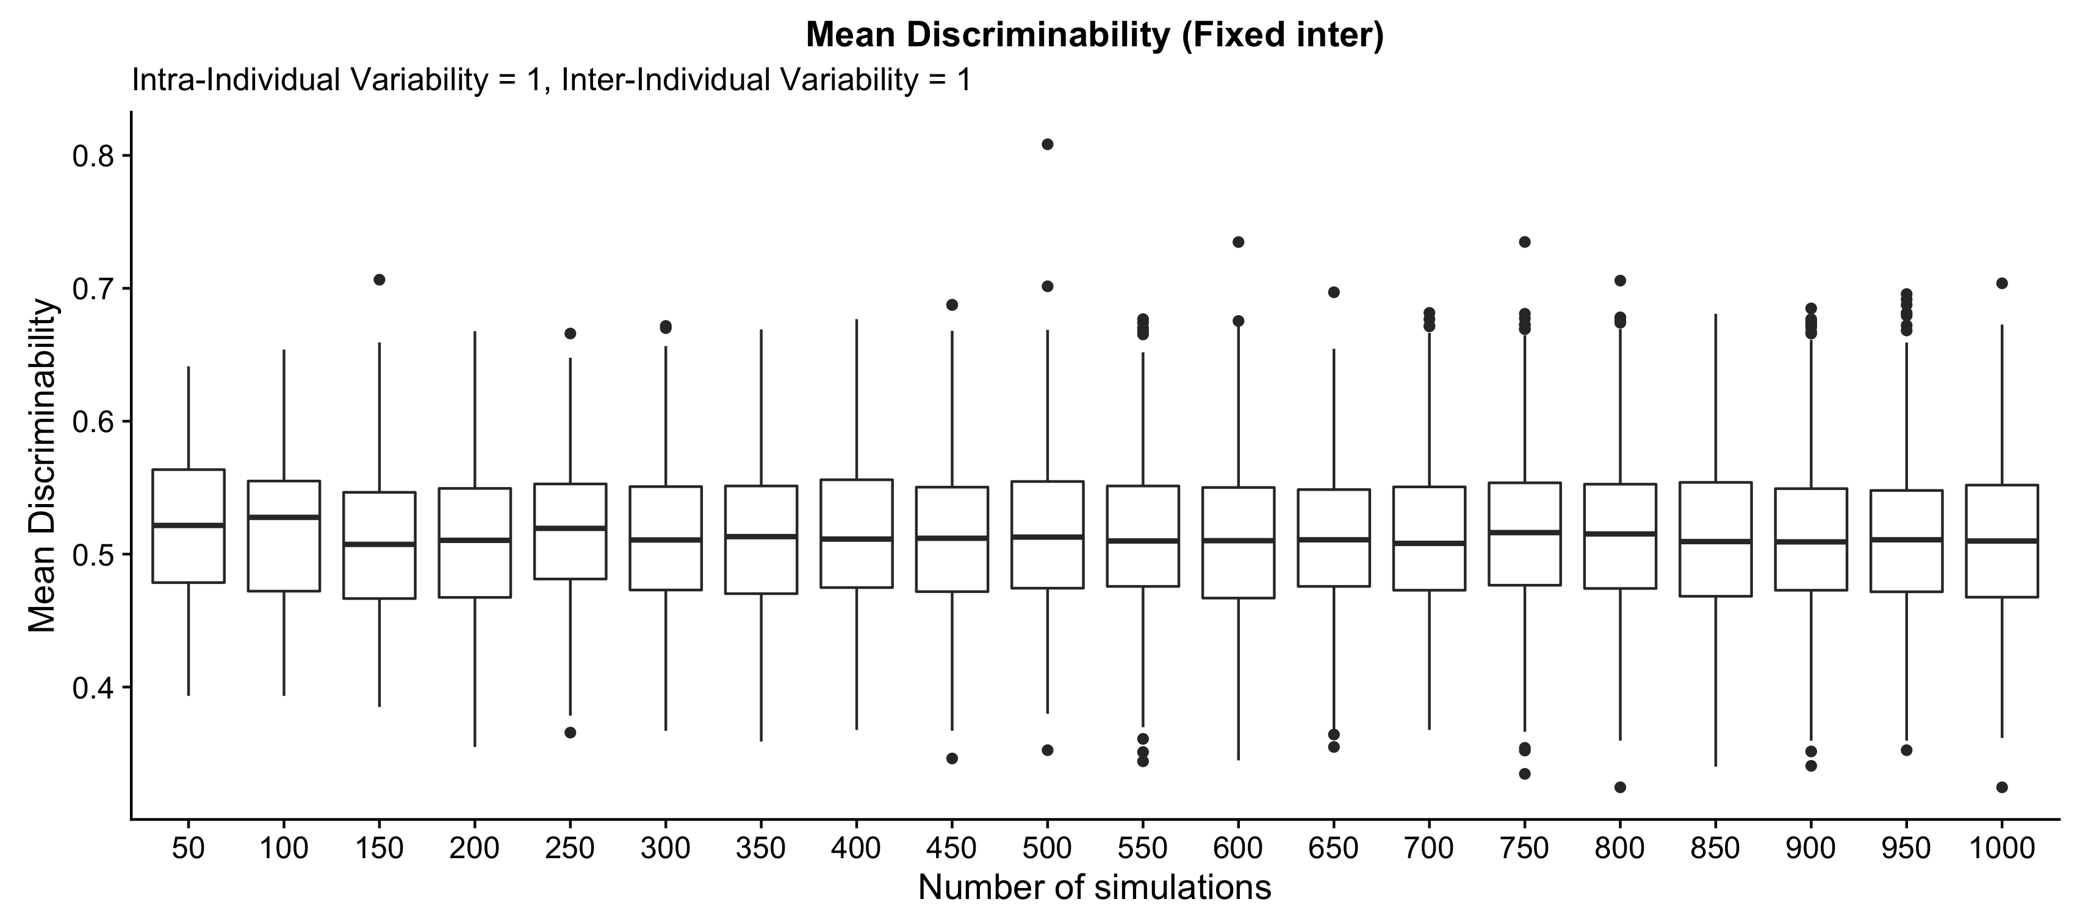

Slide 16
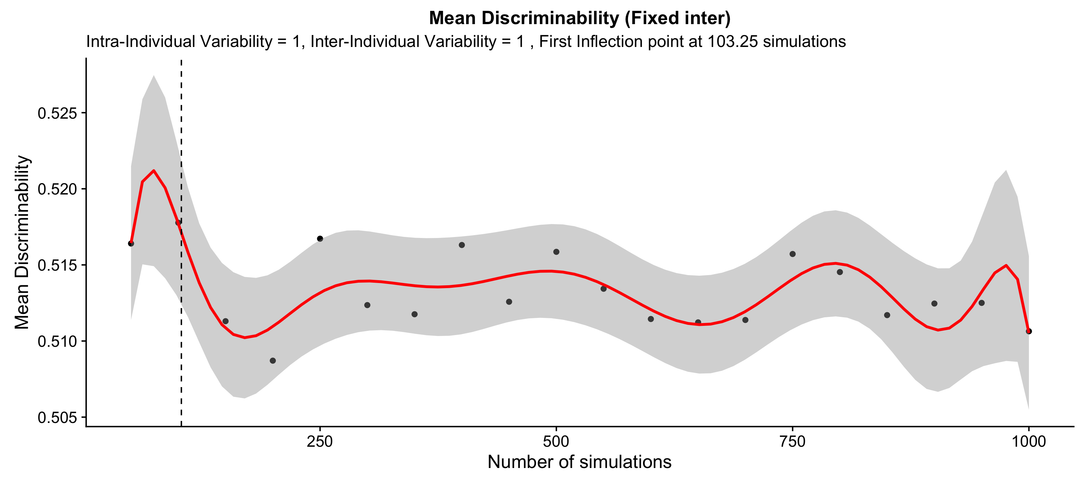

Slide 17


Slide 18
Fixed Intra-Individual Variability (n = 20)
var_inter | inflection_point
0.25 | 134.75
0.5 | 91.95
0.71 | 95.35
1 | 114.15

Slide 19
Fixed Inter-Individual Variability (n = 20)
Intra-individual variability = 0.25, inter-individual variability = 1

Slide 20
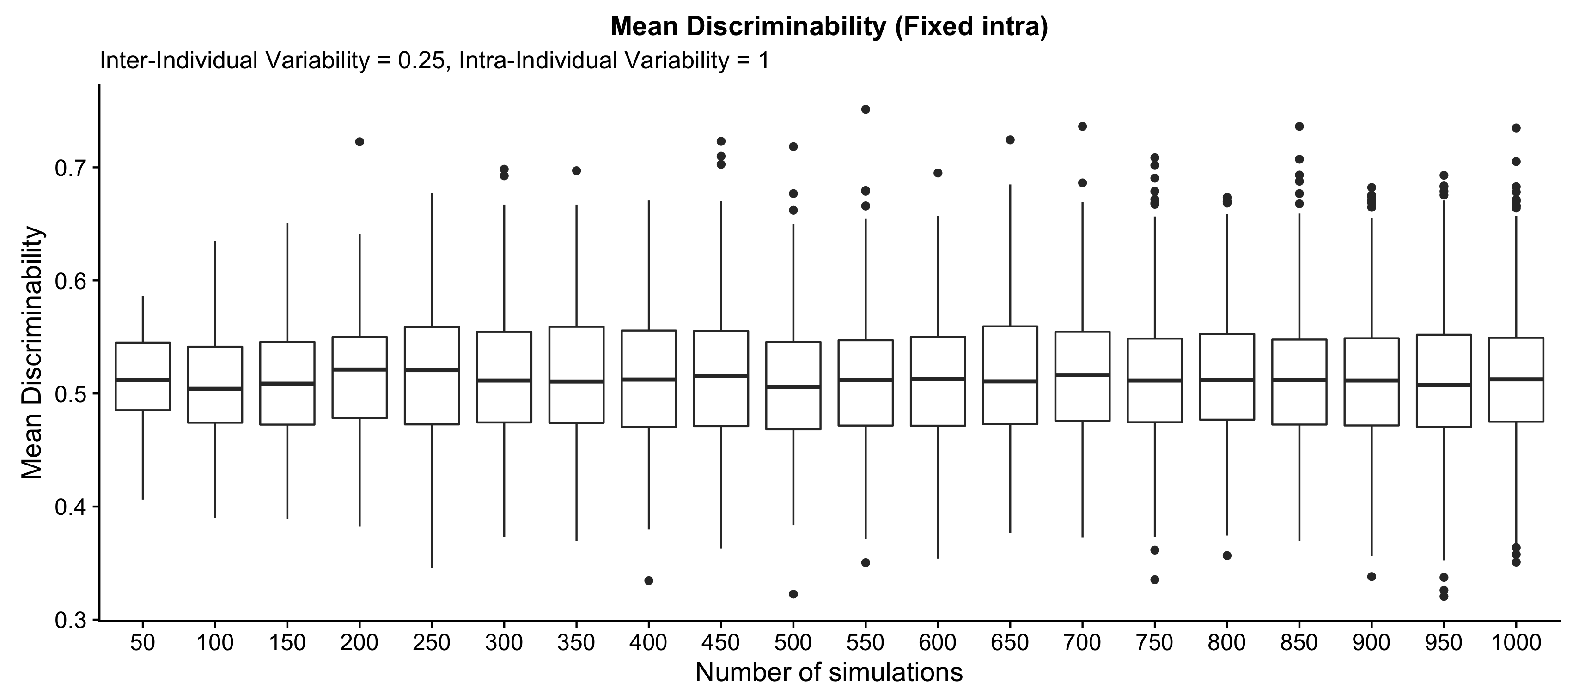

Slide 21
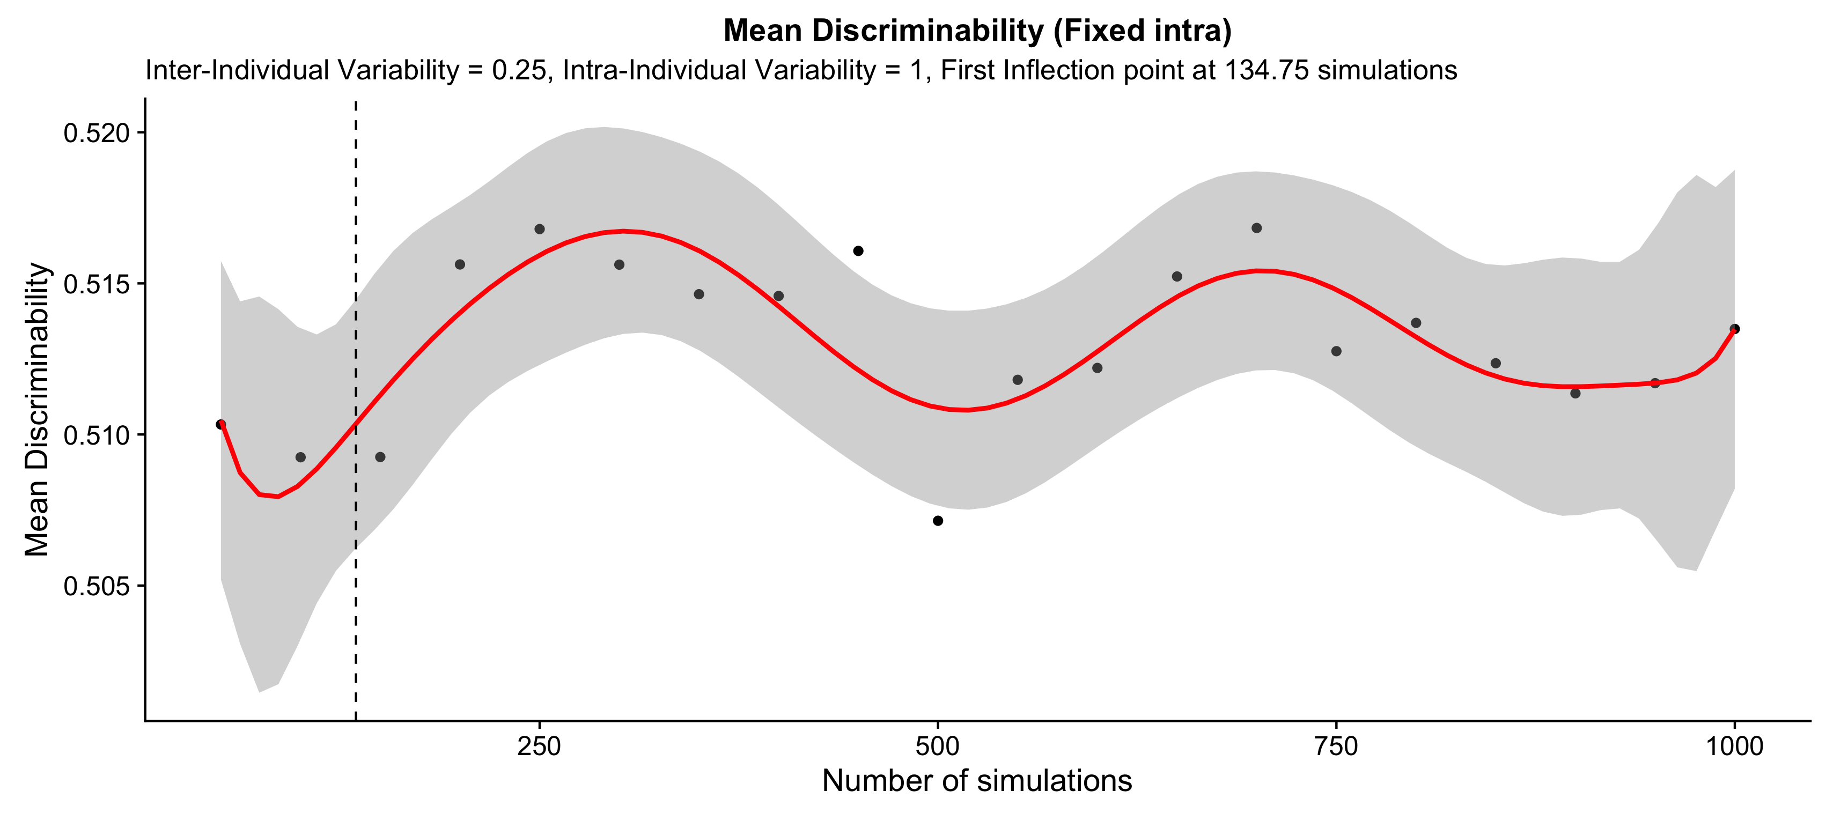

Slide 22
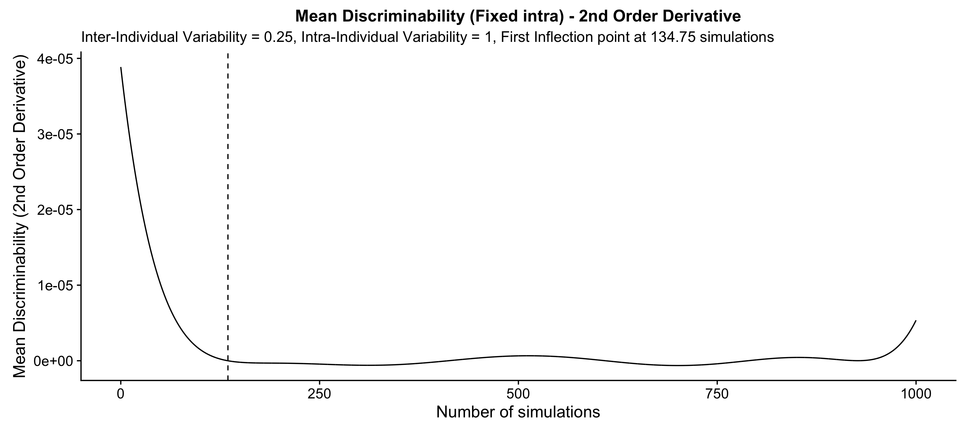

Slide 23
Fixed Inter-Individual Variability (n = 20)
Intra-individual variability = 0.50, inter-individual variability = 1

Slide 24
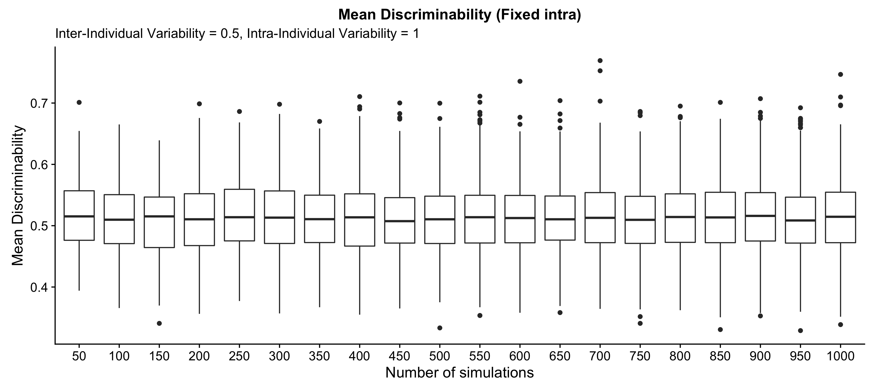

Slide 25
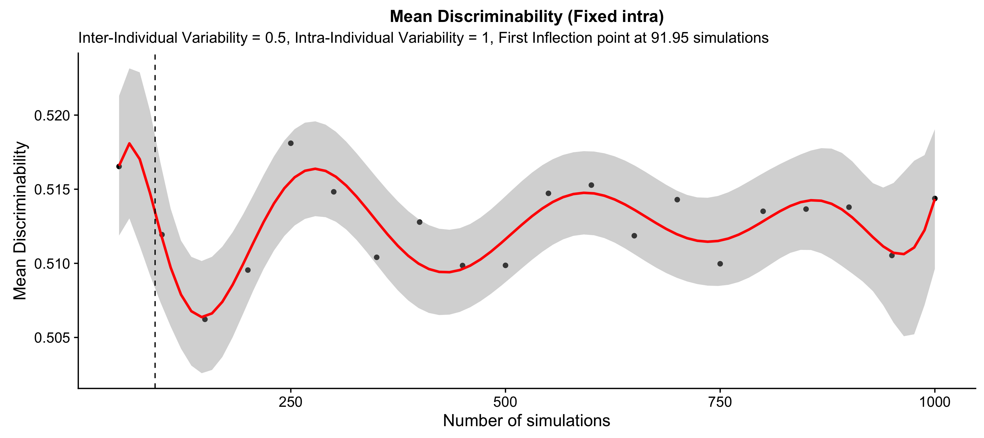

Slide 26
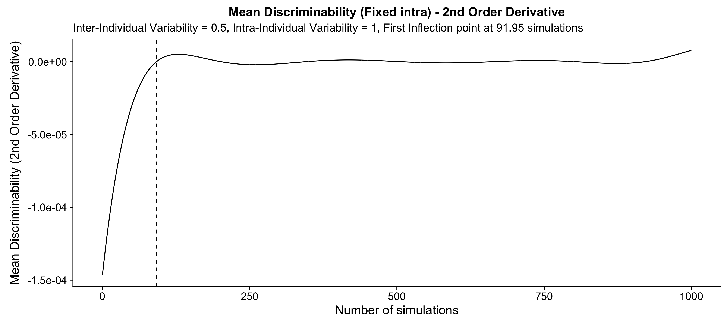

Slide 27
Fixed Inter-Individual Variability (n = 20)
Intra-individual variability = 0.71, inter-individual variability = 1

Slide 28
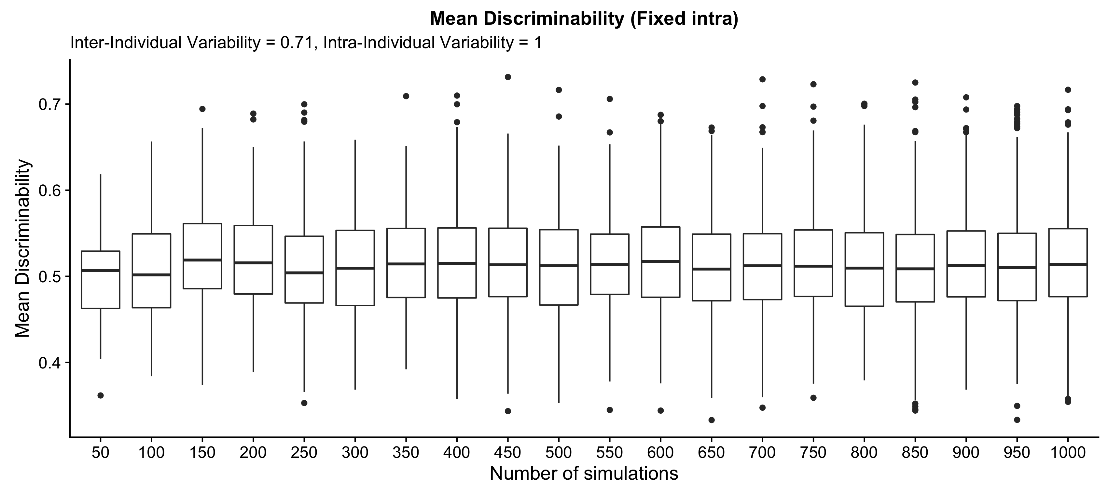

Slide 29
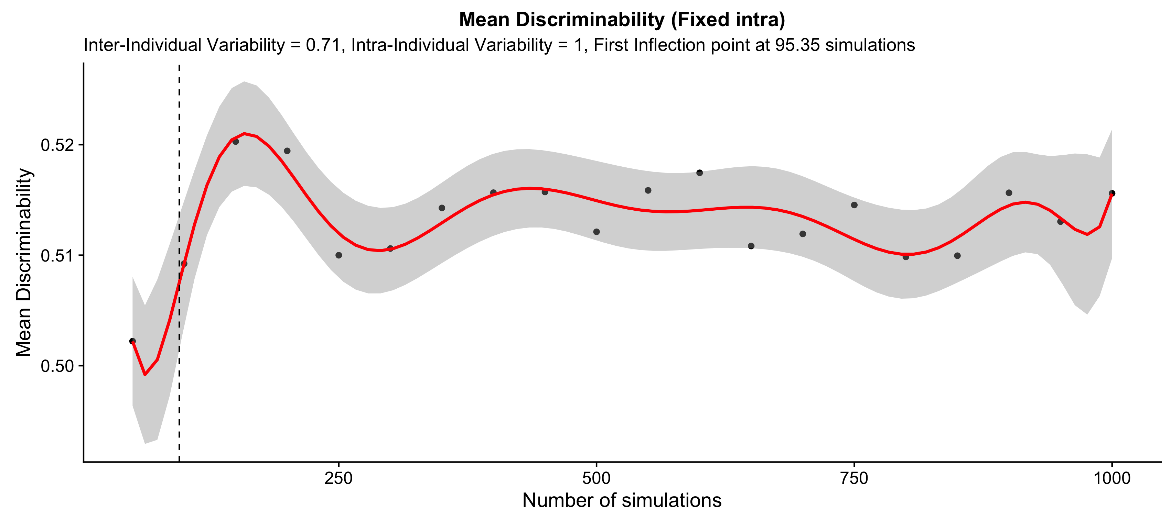

Slide 30


Slide 31
Fixed Inter-Individual Variability (n = 20)
Intra-individual variability = 1, inter-individual variability = 1

Slide 32
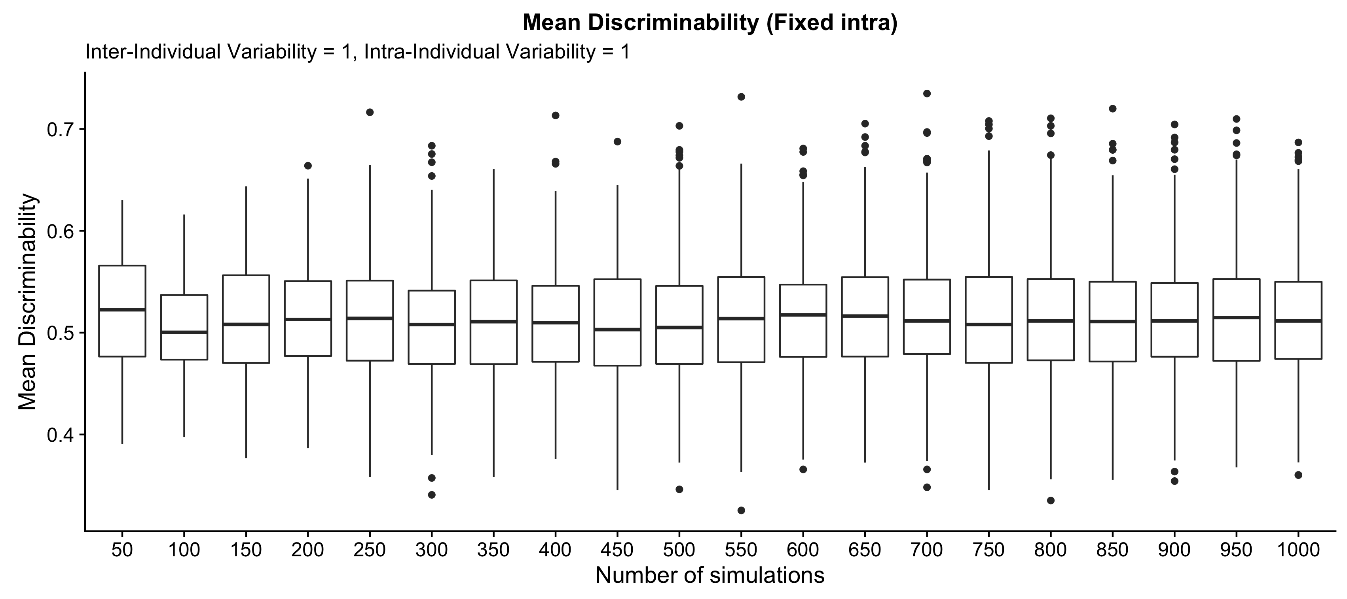

Slide 33
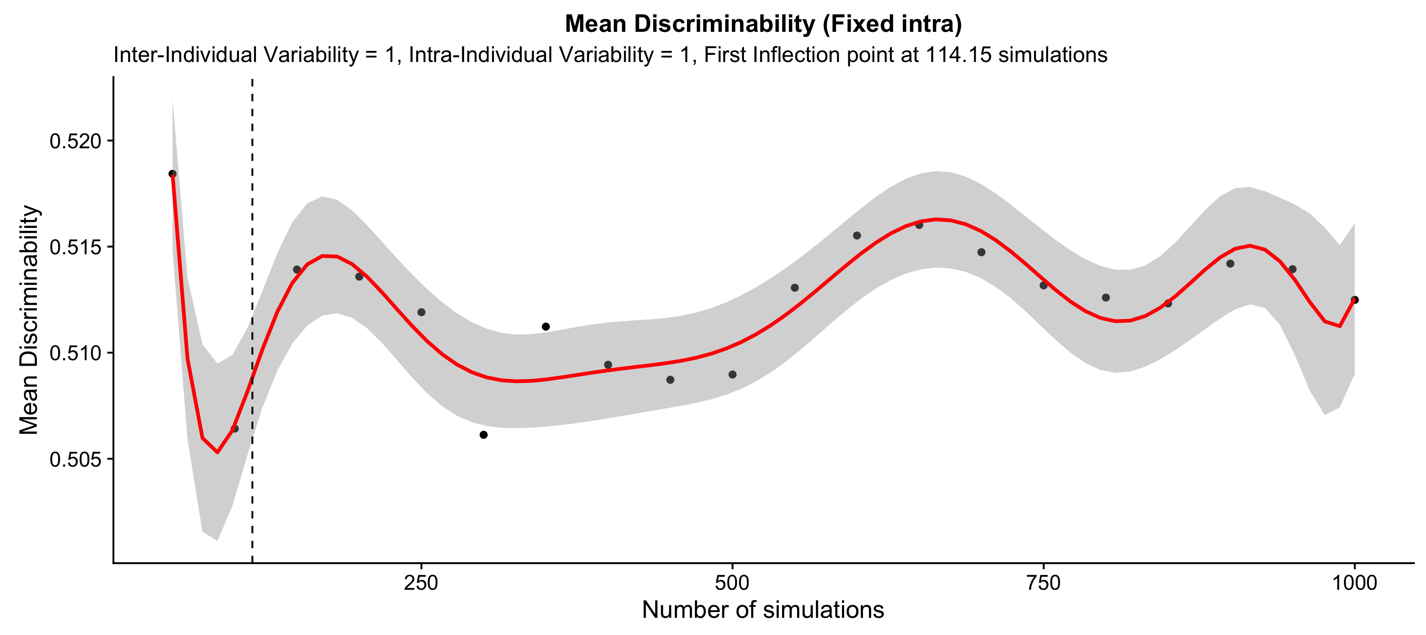

Slide 34


